Slide 1
Android Studio Files

Slide 2
Create Android Application

Slide 5
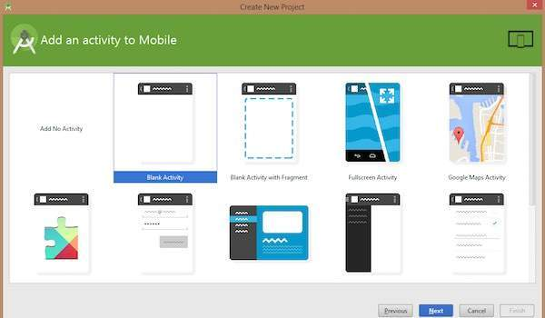

Slide 7
Anatomy of Android Application

Slide 8
Sr.No. | Folder, File & Description
1 | Java This contains the .java source files for your project. By default, it includes an MainActivity.java source file having an activity class that runs when your app is launched using the app icon.
2 | res/drawable-hdpi This is a directory for drawable objects that are designed for high-density screens.
3 | res/layout This is a directory for files that define your app's user interface.
4 | res/values This is a directory for other various XML files that contain a collection of resources, such as strings and colours definitions.
5 | AndroidManifest.xml This is the manifest file which describes the fundamental characteristics of the app and defines each of its components.
6 | Build.gradle This is an auto generated file which contains compileSdkVersion, buildToolsVersion, applicationId, minSdkVersion, targetSdkVersion, versionCode and versionName

Slide 9
The Main Activity File
The main activity code is a Java file MainActivity.java. This is the actual application file which ultimately gets converted to a Dalvik executable and runs your application. Following is the default code generated by the application wizard for Hello World! application −

Slide 10
package com.example.helloworld;
import android.support.v7.app.AppCompatActivity; import android.os.Bundle;
public class MainActivity extends AppCompatActivity
{
@Override
protected void onCreate(Bundle savedInstanceState)
{
super.onCreate(savedInstanceState); setContentView(R.layout.activity_main);
}
}

Slide 11
Here, R.layout.activity_main refers to the activity_main.xml file located in theres/layout folder. The onCreate() method is one of many methods that are figured when an activity is loaded.

Slide 12
Manifest File
Every application must have an AndroidManifest.xml file (with precisely that name) in its root directory. The manifest file provides essential information about your app to the Android system, which the system must have before it can run any of the app's code.

Slide 13
AndroidManifest.xml file in android
The AndroidManifest.xml file contains information of your package, including components of the application such as activities, services, broadcast receivers, content providers etc.
It performs some other tasks also:
It is responsible to protect the application to access any protected parts by providing the permissions.
It also declares the android api that the application is going to use.
It lists the instrumentation classes. The instrumentation classes provides profiling and other informations. These informations are removed just before the application is published etc.

Slide 14
Next
This is the required xml file for all the android application and located inside the root directory.
A simple AndroidManifest.xml file looks like this:

Slide 15
<manifest xmlns:android="http://schemas.android.com/apk/res/android"
package="com.javatpoint.hello"
android:versionCode="1"
android:versionName="1.0" >
<uses-sdk
android:minSdkVersion="8"
android:targetSdkVersion="15" />
<application
android:icon="@drawable/ic_launcher"
android:label="@string/app_name"
android:theme="@style/AppTheme" >
<activity
android:name=".MainActivity"
android:label="@string/title_activity_main" >
<intent-filter>
<action android:name="android.intent.action.MAIN" />
<category android:name="android.intent.category.LAUNCHER" />
</intent-filter>
</activity>
</application>
</manifest>

Slide 16
Cont..
<manifest>
manifest is the root element of the AndroidManifest.xml file. It has package attribute that describes the package name of the activity class.
<application>
application is the subelement of the manifest. It includes the namespace declaration. This element contains several subelements that declares the application component such as activity etc.
The commonly used attributes are of this element are icon, label, theme etc.
android:icon represents the icon for all the android application components.
android:label works as the default label for all the application components.
android:theme represents a common theme for all the android activities.

Slide 17
Cont..
<activity>
activity is the subelement of application and represents an activity that must be defined in the AndroidManifest.xml file. It has many attributes such as label, name, theme, launchMode etc.
android:label represents a label i.e. displayed on the screen.
android:name represents a name for the activity class. It is required attribute.
<intent-filter>
intent-filter is the sub-element of activity that describes the type of intent to which activity, service or broadcast receiver can respond to.
<action>
It adds an action for the intent-filter. The intent-filter must have at least one action element.
<category>
It adds a category name to an intent-filter.

Slide 18
R.java File
Android R.java is an auto-generated file by aapt (Android Asset Packaging Tool) that contains resource IDs for all the resources of res/ directory.
If you create any component in the activity_main.xml file, id for the corresponding component is automatically created in this file. This id can be used in the activity source file to perform any action on the component.
Note: If you delete R.jar file, android creates it automatically.
It includes a lot of static nested classes such as menu, id, layout, attr, drawable, string etc.

